Slide 1
UNIT-4 Project Appraisal/ Evaluation Techniques Part-I
Capital Budgeting

Slide 2
Capital Budgeting
Capital budgeting is the long term investment decision for functioning of acquires, upgrades, replaces the assets such as land and buildings, plant and machinery and different types of long term projects.
According to Charles T Horngren “Capital budgeting is the long term planning to make and finance proposed capital analysis.”
The capital budgeting decisions involve long term planning for selection and also financing the investment proposals. Capital budgeting is the process of evaluating the relative worth of long term investment proposals on the basis of their respective profitability.

Slide 3
Nature of Capital Budgeting
Capital expenditure plans involve a huge investment in fixed assets.
Capital budgeting decisions involve the exchange of current funds for the benefits to be achieved in future.
The future benefits are expected and rate to be realized over a series of years.
The funds are invested in non-flexible long term funds.
Preparation of capital budget plans involve forecasting of several years profits in advance in order to judge the profitability of projects.
In view of the investment of large amount for a fairly long period of time, any error in the evaluation of investment projects, may lead to serious consequences, the problem will be followed a series of years.

Slide 4
Need and Importance of Capital Budgeting
Efficient allocation of capital
Long-term planning
Risk assessment
Profit maximization
Cost control
Competitive advantage
Financial stability

Slide 5
Scope of Capital Budgeting
Construction of new building.
Renovation of existing building.
Purchase of technology from a foreign country.
Building a production facility.
Buying a new delivery truck.
Building a bridge.
Making a new product.
Starting a new business.
Expansion decision of existing plant and equipment.
Labor agreements.

Slide 6
Capital Budgeting-Process
Initiating, generating and gathering investments ideas.
Analyzing the costs and benefits for proposed investments by:
–Forecasting costs and benefits for each investment.
–Evaluating the costs and benefits based on CB techniques.
Ranking the relative superiority of each investment alternative based on financial performance worked out and choosing the best investment opportunity from the given set of opportunities.
Implementing the investment alternative chosen.
Monitoring & making follow-up on the investment made on regular basis to see how far this investment opportunity has been effective in the given framework of the company to achieve its desired objectives.

Slide 7
Capital budgeting Techniques
The capital budgeting appraisal methods are techniques of evaluation of investment proposal will help the company to decide upon the desirability of an investment proposal depending upon their; relative income generating capacity and rank them in order of their desirability. These methods provide the company a set of norms on the basis of which either it has to accept or reject the investment proposal. The most widely accepted techniques used in estimating the cost-returns of investment projects can be grouped under two categories.
1. Traditional methods
2. Discounted Cash flow methods

Slide 8
Capital budgeting Techniques
1. Traditional methods
a. Payback Period
b. Accounting Rate of Return
2. Discounted cash flow methods or modern methods
a. Net Present Value (NPV)
B. Profitability Index (PI)
c. Internal Rate of Return (IRR)

Slide 9
Capital budgeting Techniques Traditional Methods
These methods are based on the principles to determine the desirability of an investment project on the basis of its useful life and expected returns. These method depend upon the accounting information available from the books of accounts of the company. These will not take into account the concept of ‘time value of money’, which is a significant factor to determine the desirability of a project in terms of present value.

Slide 10
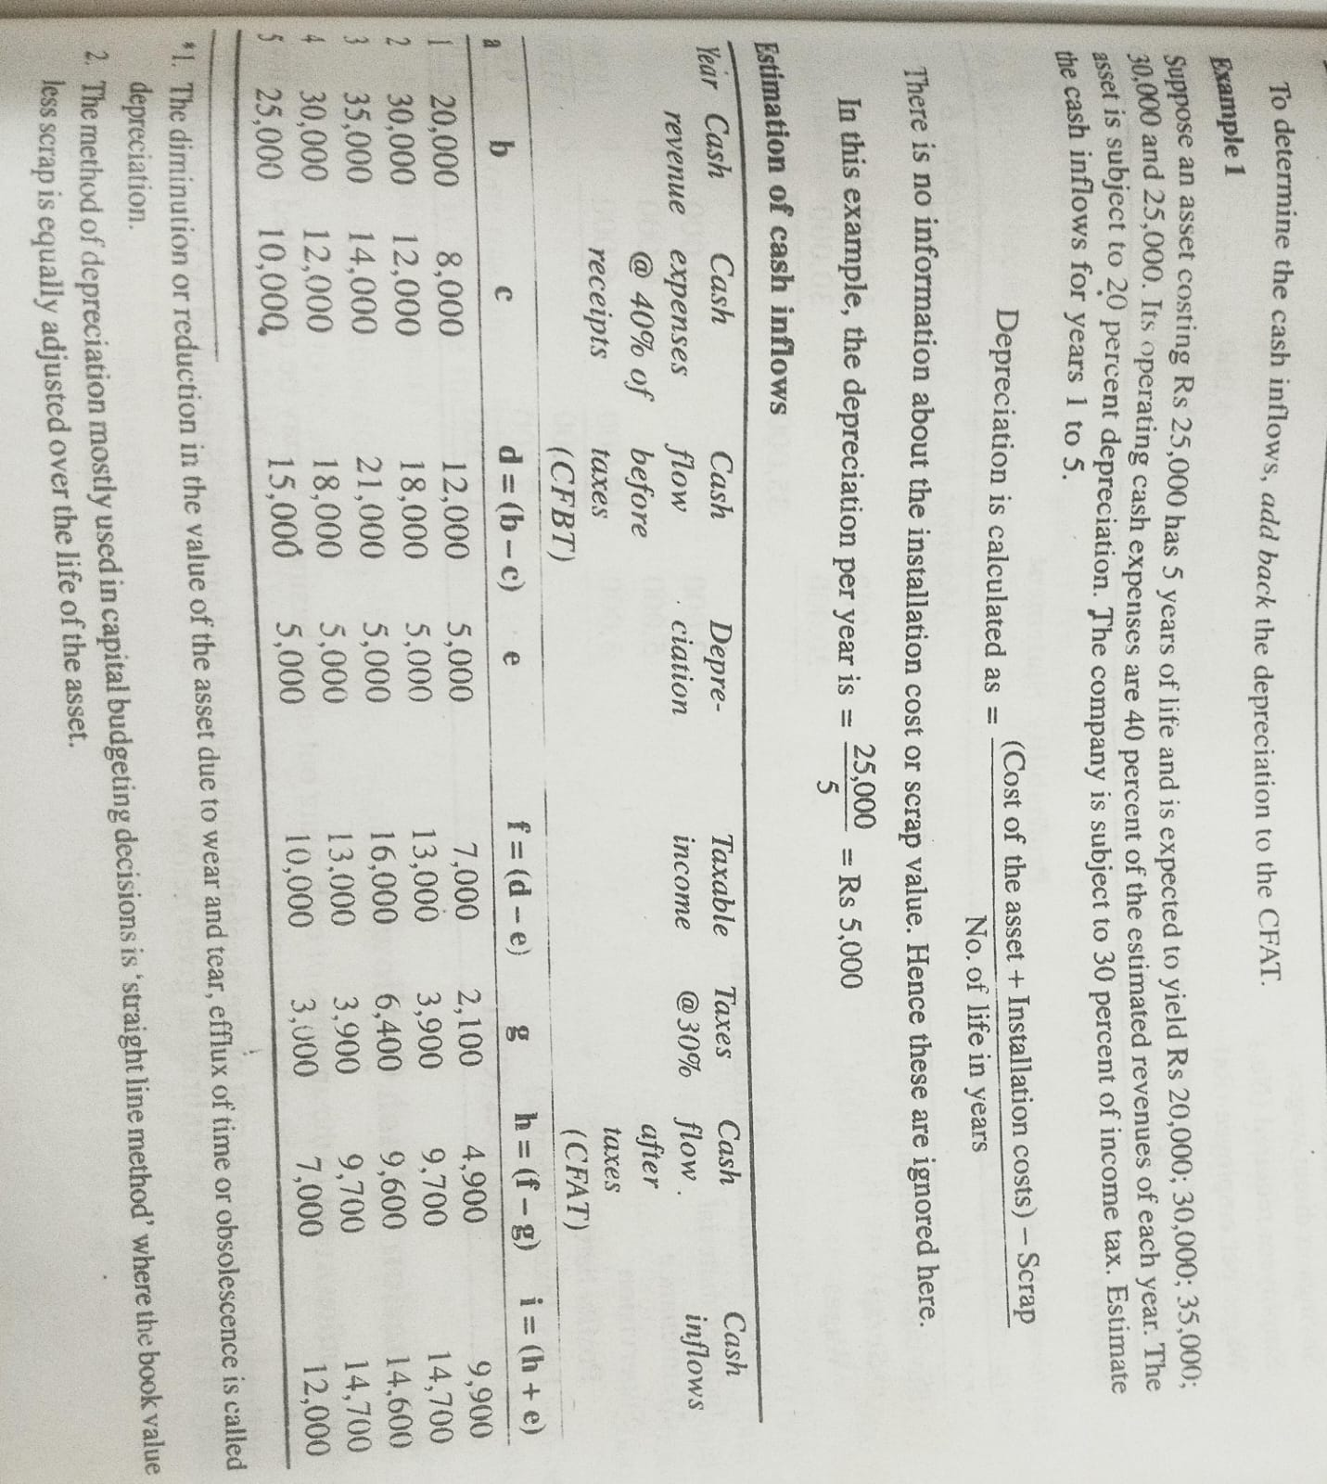

Slide 11
Traditional Methods
Payback Period Method
It is the most popular and widely recognized traditional method of evaluatin the investment proposals. It can be defined, as ‘the number of years required to recover the original cash out lay invested in a project’.
According to Weston & Brigham,
“The pay back period is the number of years it takes the firm to recover its original investment by net returns before depreciation, but after taxes”.
According to James. C. Vanhorne,
“The payback period is the number of years required to recover initial cash investment.

Slide 12
Traditional Methods-Payback Period Method
Advantages
Easy to calculate an understand
Liquidity is emphasized
Reliable technique in volatile business conditions
Disadvantages
Post-payback earnings ignored
Timing of cash flows ignored
Liquidity is over-emphasized:

Slide 13
Pay Back Method:
The pay-back period can be ascertained in the following manner:
(1) Calculate annual net earnings (profits) before depreciation and after taxes; these are called annual cash inflows.
(2) Divide the initial outlay (cost) of the project by the annual cash inflow, where the project generates constant annual cash inflows.
Thus, where the project generates constant cash inflows.
Payback period = C𝒂𝒔𝒉 𝒐𝒖𝒕𝒍𝒂𝒚 (𝑶𝑹)𝑶𝒓𝒊𝒈𝒊𝒏𝒂𝒍 𝒄𝒐𝒔𝒕 𝒐𝒇 𝒑𝒓𝒐𝒋𝒆𝒄𝒕
A𝒏𝒏𝒖𝒂𝒍 𝒄𝒂𝒔𝒉 𝒊𝒏𝒇𝒍𝒐𝒘

Slide 14
Traditional Methods-Payback period method
Where the cash flows are uneven
(3) Where the annual cash inflows (Profit before depreciation and after taxes) are unequal, the pay­back period can be found by adding up the cash inflows until the total is equal to the initial cash outlay of project or original cost of the asset.
Payback period = based year + amount to be recouped
Next year cash flows
The shorter the length of the payback period, the better is the project in terms of paying back the original investment particularly where the future is uncertain the companies favour this method the better it is in terms of safety and liquidity.

Slide 15
The cost of a project is Rs 50,000 the annual cash inflows for the next 4 years are Rs 25,000, What is the payback period for the project?
Payback period= Cost of the project /Annual cash inflows = 50000/25000= 2 years
If another project has 3 years, for example, it is better to choose the above project because it has less payback period.

Slide 16
Where the cash inflows are same., but timing is different.
At times, the cash inflows may be different each year, but the total cash inflows over the life of the project may be the same. Sometimes, the payback period may be similar. In such a case, observe the timing of the cash inflows. Choose the project which has higher cash inflows in the initial years.
Two projects, costing Rs 20,000 each, have the following cash inflows. Both have the same payback period. Which one do you choose and why?Ans Project B
Year Project A Project B
1. 8000 12,000
2. 12,000 8,000

Slide 17
Where the cashflows are uneven
Where the cash flows are not uniform, they are said to be uneven. In such a case take the cumulative cash inflows and see how much time it takes to get back the original investment.
The cost of a project is 50000which has an expected life of 5 years. The cash inflows for next 5 years The Rs 24,000: Rs 26,000; Rs 20,000; Rs 17,000 and Rs 16,000 sp the cash inflows for next years period.
ThuleCash Inflows and Cumulative Cash Inflows for the Project
Year Cash inflows (Rs) Cumulative cash inflows (Rs)
1 24,000 24,000
2 26,000 50.000
3 20,000 70,000
4 17,000 87,000
5 16,000 1,03,000
The original investment can be recovered by the end of the second year and hence the project has 2 years of payback period.

Slide 18


Slide 19
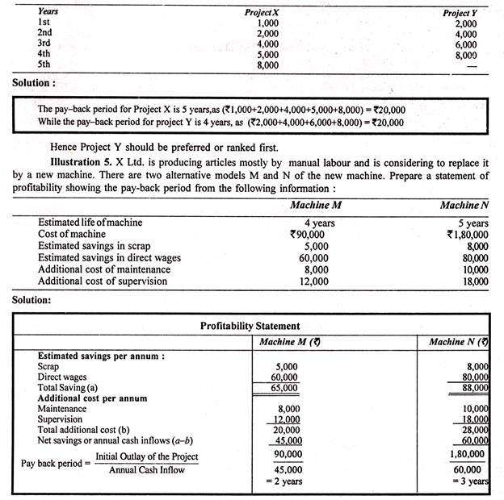

Slide 20
When inflows are not even
Cost of the project is 24,000
Inflows 4000,8000,8000,10000for four years. Calculate Payback period.
Year Annual Inflows Cumulative Annual Cash Inflows(CACI)
1 4000 4000
2 8000 12000
3 8000 20000
4 10000 30000
Formula in case of uneven inflows
=Lower yr+ Cost of the project- CACI of Lower yr = 3+(24000-20000)
CACI of Upper yr- CACI of Lower yr 30000-20000

Slide 21
As pay-back period in case of machine M is less than that in case of machine N, machine M is recommended.

Slide 22
Accounting Rate of Return
Accounting Rate of Return (ARR) Method
Accounting rate of return refers to the ratio of annual profits after taxes to the average investment. The Average investment equal to half of the original investment. Accounting rate of return is also called average rate of return.)
ARR = Average annual profits after taxes
Average investment
Average annual profit= Total inflows
Project life
​
Where average investment is half of the capital outlay (that is, Capital outlay divided by 2). Average capital employed is calculated to the usual accounting convention that the original investment gets exhausted steadily to zero over the life of the project.
It is assumed that the asset is depreciated as per straight line method. Usually it is expressed in terms of percentage. The higher the ARR is, the better is the profitability and hence the projects with higher accounting rate of return are short-listed for implementation.
At times, ARR is determined considering the original cost of the project as the denominator.

Slide 23
ARR
ARR can be calculated in two ways
1)ARR on Average Capital= Average Annual Profits after taxes *100
Average investment
2)ARR on Original Capital= Average Annual Profits after taxes *100
Original investment
If There is Working Capital and Scrap, ARR is calculated :
Where there is scrap resulting from the sale of the old asset and there is working capital, these two are added to the average investment. These are shown in the following formula.
Average investment= (Cost-Scrap)/2 + Scrap of old asset + Working capital

Slide 24
Traditional Methods-ARR Method
Advantages
1) It is easy to understand and calculate.
2) It can be compared with the cutoff point of return and hence the decision to accept or reject is made easier.
3) It considers all the cash inflows during the life of the projects, not like payback method.
4) It is a reliable measure because it considers net earnings after depreciation interest and taxes.
Disadvantages
The concept of time value of money is ignored.
Unless we have a cutoff point of return, accounting rat of return cannot be meaningful and effective.
The average concept is not reliable particularly in terms of high or wild fluctuations in the returns.
The average concept dilutes the profitability of the project.

Slide 25
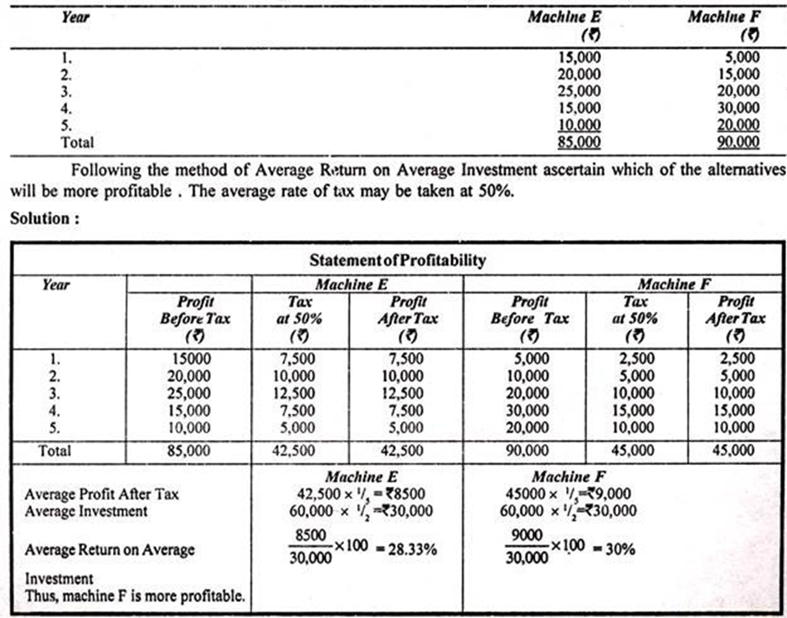
X Ltd. is considering the purchase of a machine. Two machines are available E and F. The cost of each machine is Rs 60,000. Each machine has an expected life of 5 years. Net Profits before tax and after depreciation during the expected life of the machines are given below:

Slide 26
Find out the Average rate of return from the following data relating to CNC Machines 1 and 2.
Cost Rs 300,000 each
Estimated life 3 years and for CNC Machine 1 and 4 years for CNC Machine 2
Estimated scrap 60,000 each
Income tax rate 50%
Additional Working Capital required for each Machine=Rs.250000
The estimated cash inflows after taxes for each machine are as given below:
Year CNC Machine 1 Rs CNC Machine 2 Rs
1 1,50,000 2,00,000
2 3,00,000 3,00,000
3 1,50,000 2,50,000
4 - 1,50,000
Total 6,00,000 9,00,000

Slide 27
Solution
The average cash inflows after taxes for CNC Machine 1 = Rs 2,00,000 that is, ( 6,00,000/3)
The average cash inflows after taxes for CNC Machine 2=Rs 2,25,000 that is, ( 9,00,000/4)
Average Capital= (Cost-Scrap)/ 2 +working capital+Scrap
= (3,00,000 – 60,000)/2 + 2 ,50,000+60,000 = 1,20,000+250,000+60,000 = Rs 4,30,000
ARR for Machine 1 = Average annual profits after taxes
Average investment
= (2,00,000)/(4,30,000) = 46.5%
ARR for Machine 2 =(2,25,000) /(4,30,000) = 52.32%
Based on the accounting rate of return, the machine 2 is profitable.

Slide 28
Discounted Cash Flow Methods
Discounted cash flows are the future cash inflows reduced to their present value based on a discounting factor. The process of reducing the future cash inflows to their present value based on a discounting factor or cut-off return is called discounting.
Net Present Value (NPV)
Profitability Index (PI)
Internal Rate of Return (IRR)

Slide 29
Net Present Value (NPV)
Net present value refers to the excess of present value of future cash inflows over and above the cost of original investment.
NPV=PVcFAT - (PVc)
Where
PVcFAT refers to the present value of cash flows after taxes.
PVc refers to the present value of original investment or capital
The NPV should always be positive and should be maximum. The present value factor tables are used here to determine the present value of the future cash inflows.

Slide 30
NPV-Advantages
since the PV factor tables are available determination of NPV is relatively easier. It is easy to understand.
The goal of the financial management is wealth maximization and this method enables the finance manager to pursue this goal.
It is based on the concept of time value and considers the total earnings and expenses of the project.
NPV is a superior technique to IRR in case of mutually exclusive proposals.
Each project can individually be evaluated.

Slide 31
NPV-Disadvantages
It is difficult to determine the appropriate discount rate.
The calculations are easier when compared to IRR, but is beyond the comprehension of a common businessman
It does not indicate the cost of capital.
Where projects differ in their duration and their cash flows, this method cannot be used. (It is her profitability index is used)

Slide 32
Net Present Value
NPV:
A project’s net present value (NPV) is defined as the difference between present value of total cash inflow and the present value of total cash outflow over the life of the project.
Present value of a cash flow means the amount of cash due to be received or paid at a future point of time, discounted using an appropriate discount factor which in most cases is the company’s cost of capital.
The cost of capital of a business is the minimum combined rate of return that its investors (shareholders and creditors) expect from a business.
The projects with positive NPV promise a positive overall cash flow. Such projects are considered desirable and are therefore accepted. The project with a negative NPV indicate a negative overall cash flow. These projects are considered undesirable and are not undertaken.
Formula of NPV
NPV = Total present value of Cash inflows - Total present value of Cash outflows

Slide 33
The stages in the determination of NPV
1. From the PV factor table, identify the PV factors of Re 1 for the given discount rate (PV)
2. Multiply the cash flows (both outflows and inflows) with the corresponding PV factor to find the products DCF =(PV)*(CFAT)
3. Find the sum of the products
4.Apply the formula NPV=(PV cfat ) minus (PVc)
( If the NPV is positive, that means, the project is profitable. In case of projects with different NPVs. choose the project with the highest NPV because, the higher the NPV, the higher is the profitability.)
Interpretation
NPV > 1 which means that the project earns more than the discount rate
NPV = 1 which means that the project earns the same as the discount rate
NPV < 1 which means that the project earns less than the discount rate

Slide 34
NPV in case of Even Cash Inflows
Problem: NPV determination in case of even cash inflows
Given that a project costing Rs 40,000 has annual cash inflows of Rs 20,000 after taxes for a period of 6 years. How much is the net present value if the firm expects 15 percent per annum?
Net present Value = (PVCFAT) minus (PVC) PV (annuity) factor @ 15 percent for six years= 3.784 PV CFAT = 20000 * 3.784 = Rs 75,680 NPV = 75,680 - 40000 = Rs 35,680

Slide 35
Problem on NPV when uneven cash flows
Cost of Capital Rs. 50000/-
Inflows 20000,40000,35000,67000,16000 for 5 years.
Year CFAT PV(10%) PVCFAT
1 20000 .909 18180
2 40000 .826 33040
3 35000 .751 26285
4 67000 .683 45761
5 16000 .621 9936
TOTAL = 133202
PVC= -50000
NPV= 83202

Slide 36
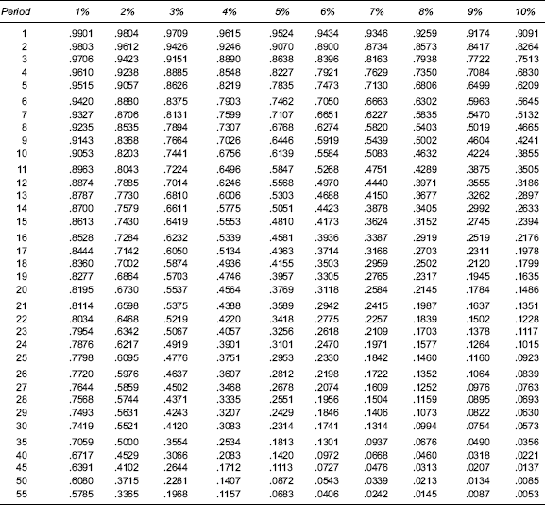
Table 1: Present Value of Re 1 Due at the End of n Periods

Slide 37
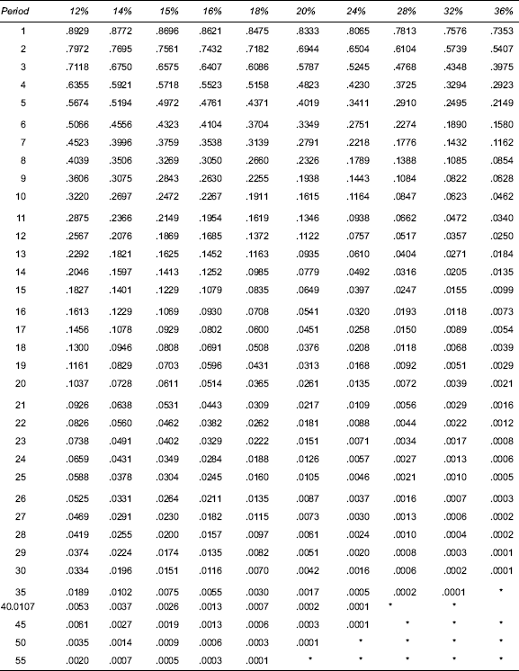
Table 1: Present Value of Re 1 Due at the End of n Periods

Slide 38

Table 2: Present Value of an Annuity of Re 1 per Period for n Periods (Cumulative)

Slide 39

Table 2: Present Value of an Annuity of Re 1 per Period for n Periods (Cumulative)

Slide 40
IRR
The internal rate of return (IRR) is the rate of interest at which the NPV of a project becomes zero. It means that at this interest rate a particular project stands at break-even. The projects whose IRR is greater than the company’s cost of capital are considered desirable and therefore accepted. Any project whose IRR is below the cost of capital of the company is not desirable and should be avoided.
As stated earlier that IRR is a rate at which NPV of a project equals to zero, therefore any project that promises an IRR below the cost of capital indicates that its NPV is negative and it should not be undertaken.
IRR=Lower Rate+[PVCFAT-PVc]*∆R
∆PV
(Pvcfat at lower rate)

Slide 41
Evaluation of IRR
The internal rate of return is compared with the cost of the capital. If the IRR is more than the cost of capital, the project is profitable, otherwise it is not. Where there are two projects with different IRRS, select the project with higher IRR.
IRR and Even Cash Flows
Where cash inflows are even, it is relatively easy to compute IRR based on a factor located from the cumulative present value of Re I.
EX:
A project costs Rs 1,44,000. The average annual cash inflows are likely to be Rs 45,000 for a period of 5 years. Calculate the IRR for the project.
Factor= Project cost
Annual cash inflows
= 1, 44000/45000 = 3.2
Cont…..

Slide 42
Cont….
From the Table the cumulative present value of Re 1 received annually for N years, find out between which rates of return, the factor 3.2 is lying. From the Table, it can be seen that 3.2 is lying between 3.274 and 3.127 the corresponding rates of return are 16 percent and 18 percent respectively. Since 3.2 is close to 16 percent, the IRR can be considered as close to 16 percent. However, the exact percentage can be determined by interpolation method

Slide 43
Difference between NPV and IRR:
1. Outcome value:
The net present value (NPV) technique of investment appraisal shows the estimated net value of return in monetary terms that the project would generate. It considers the discounted value of all the possible cash outflows and inflows regarding a specific project and then compares the two to get a net positive or negative cash flow known as net present value.
The internal rate of return (IRR) method shows the value of return for a project in percentage terms. If IRR is applied to the cash flows of a project instead of cost of capital, the NPV of the project would be zero.
2. Basis of decision:
Generally, a project is accepted if its NPV is positive or it shows surplus funds at the end of the project. However, it is possible that a project generates positive cash flows but the business is still not ready to accept it because the positive NPV does not match the NPV set by the management of the business.
IRR is used to appraise the sensitivity of cost of capital which is used to appraise a project. IRR effectively shows a percentage below which NPV would start to fall negative. Therefore if IRR is greater than the cost of capital, the project is accepted and otherwise rejected.
3. Assumptions:
The NPV technique assumes that the cash inflows generated by the project are reinvested at the cost of capital of the business. This assumption is somehow realistic because the cost of capital of a business indicates the risk that a business is already facing in its investments.
The IRR method assumes that the cash inflows are reinvested at IRR or internal rate of return.

Slide 44
NPV Vs IRR
NPV is the difference between the present value of cash inflows and the present value of cash outflows over a period of time. By contrast, the internal rate of return (IRR) is a calculation used to estimate the profitability of potential investments.

Slide 45
Profitability Index
Profitability index shows the relationship between company projects future cash inflows and initial investment(Present value of cash outflows)
by calculating the ratio and analyzing the project viability and it is calculated by one plus dividing the present value of cash flows by initial investment and it is also known as profit investment ratio as it analyses the profit of the project.
Profitability Index = sum of Present Value of Future Cash Inflows
sum of Present value of cash outflows

Slide 46
Profitability Index
This is the ratio of the present value of cash inflows and the present value of cash outflows. It is used to indicate the profitability at a glance.
Where the projects differ in their duration and the cash flows these can be compared based on the profitability index.
INTERPRETATIONS
If the profitability index is less than one reject the proposal.
If the profitability index is equal to one, the proposal is just break eve.
If the profitability is more than one accept the proposal.
The higher the index, the more profitable the proposal is

Slide 47
Problem on Profitability Index
Calculate the profitability index for the project particulars given
A firm has many projects. It wants to earn at least 6 % pa on this project with the following cash flows.
The sum of present values of cash inflows= Rs 1,57,070
The sum of present values of cash outflows = Rs 1,38,860
Profitability Index= Sum of present value of cash inflows
Sum of present value of cash outflows
= (1, 57,070)/(138860) = 1.32
The profitability index of 1.32 shows that the proposal is profitable
(as it is more than one) and can be accepted
Year | 0 | 1 | 2 | 3 | 4 | 5 | 6
Cash inflows |  |  | 30000 | 40000 | 40000 | 40000 | 50000
Cash Outflows | 100000 | 20000

Slide 48
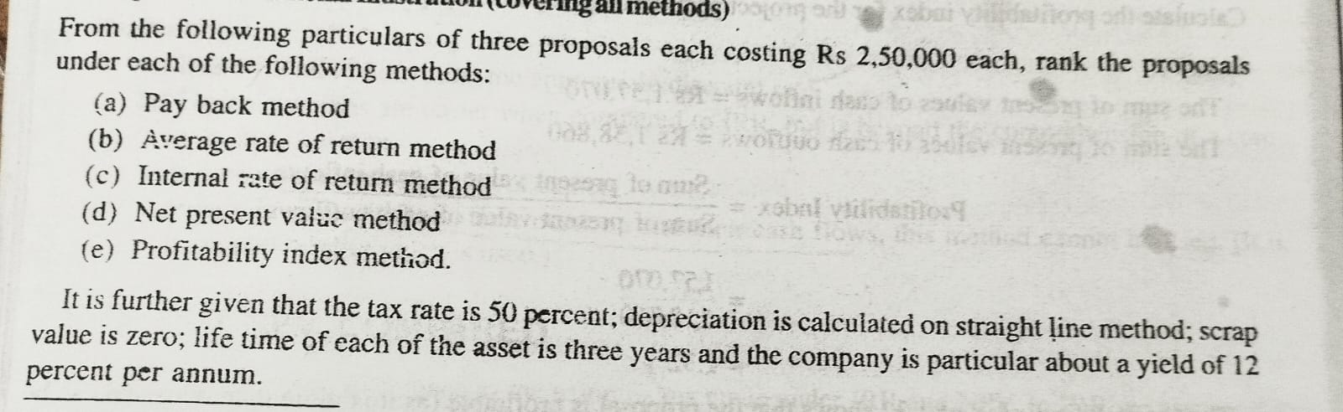
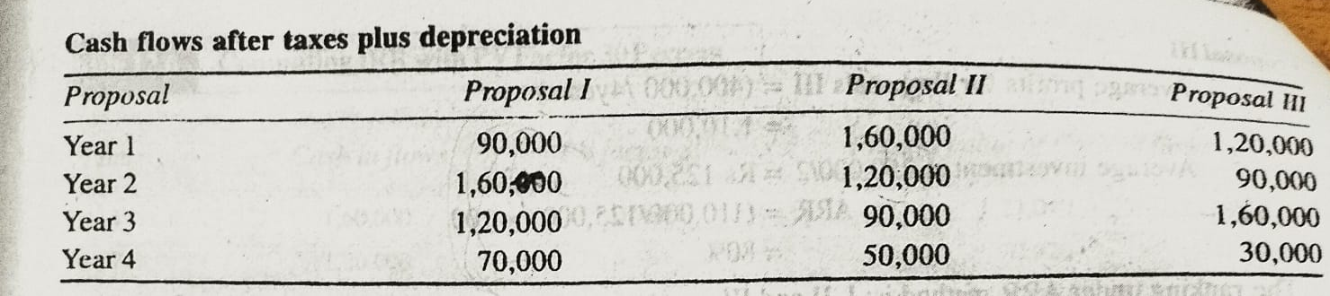
PROBLEM ON ALL METHODS

